Slide 1
Constructing rhombi
Constructions

Slide 2
how to use Oak lessons

Slide 3
I can use intersecting circles to construct rhombi from given lengths.

Slide 4
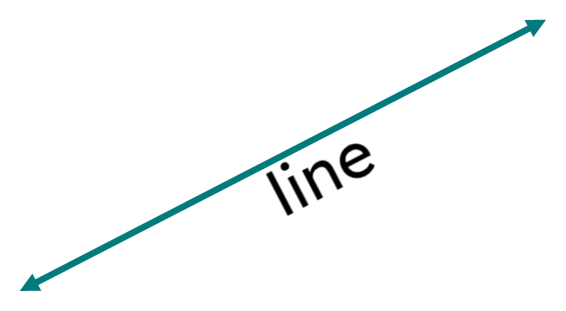
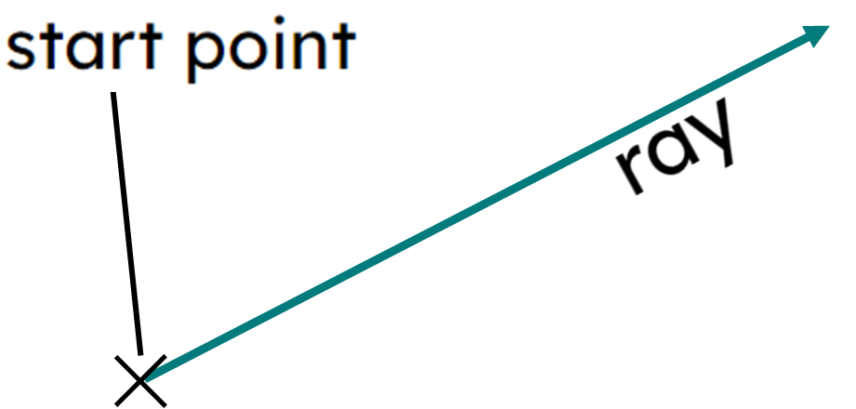
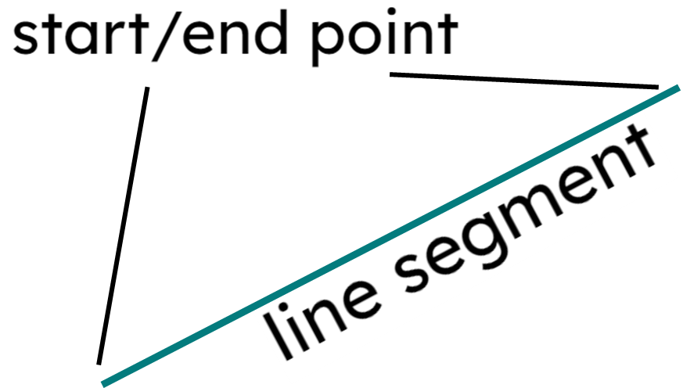
A line is a straight 1D figure that does not have a thickness, and it extends forever in both directions.
A ray is a part of a line with a fixed starting point that extends forever in one direction.
A line segment is a part of a line with a fixed start point and a distinct fixed end point.
The radius is any line segment that joins the centre of a circle to any point on its circumference.

Slide 5
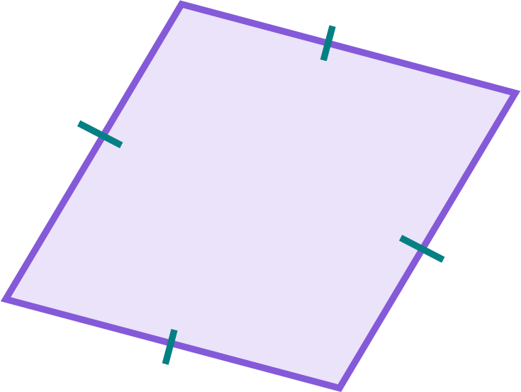
A rhombus is a parallelogram where all sides are the same length.
The plural of rhombus can be referred to as rhombi.

Slide 6

Constructing rhombi
Creating shapes from triangles
Constructing rhombi

Slide 7



Creating shapes from triangles
I can construct any triangle if I know the three edge lengths.
I think that means you can construct quadrilaterals too.
All quadrilaterals can be split into two triangles.
Aisha
Izzy

Slide 8
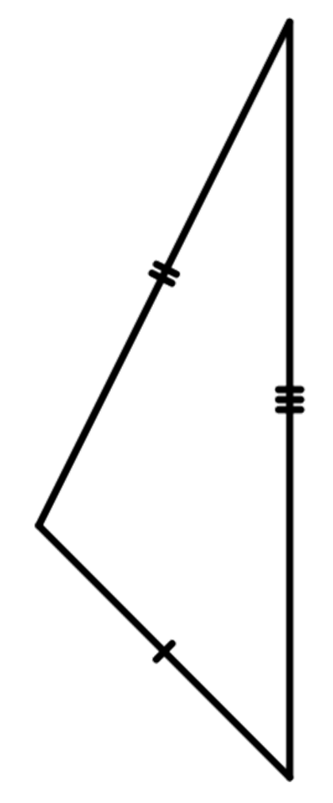
Creating shapes from triangles
So if I construct a scalene triangle, what quadrilaterals can I construct?
Hmm…I am not too sure. Let’s see.
If we have two copies of the triangle, how can we join them up?
Aisha
Izzy

Slide 9
Creating shapes from triangles
Opposite edges are equal lengths, so this is a parallelogram.
Can we have it any other way?
Aisha
Izzy

Slide 10
Creating shapes from triangles
Adjacent edges are equal, this is a kite!
I think if you join other matching edges you still make kites and parallelograms.
Aisha
Izzy

Slide 11
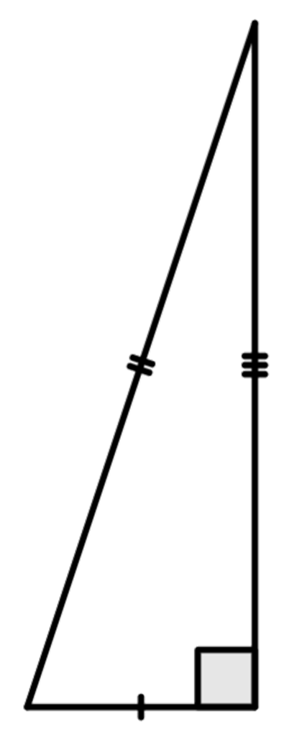
Creating shapes from triangles
So I can construct kites and parallelograms.
Yes and if it was a right angled scalene triangle, then the parallelogram is a rectangle and the kite is a triangle?
Aisha
Izzy

Slide 12
Creating shapes from triangles
A parallelogram, a rectangle or an isosceles triangle.
Aisha
Izzy

Slide 13
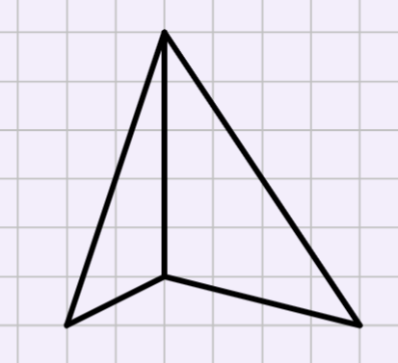
Creating shapes from triangles
Two different scalene triangles, with one shared edge length, are joined together.
Name the shape created.
Irregular quadrilateral

Slide 14
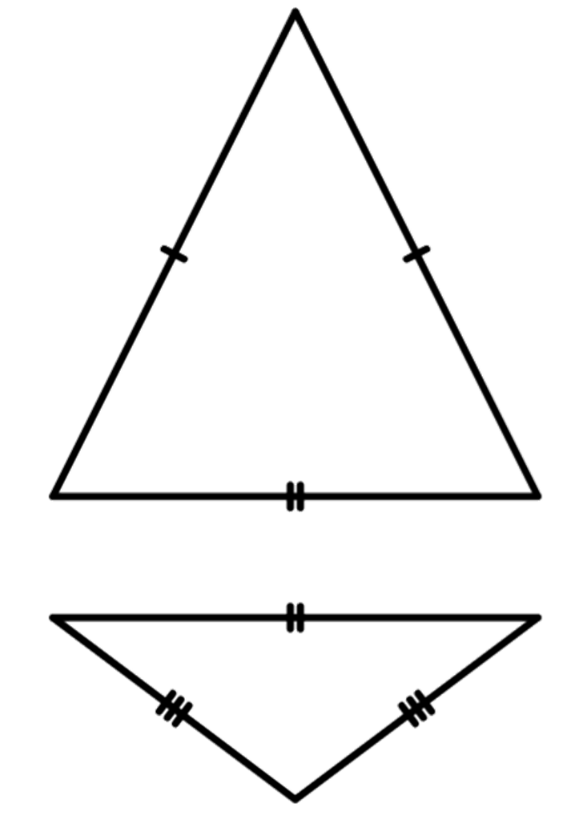
Creating shapes from triangles
What if we used two isosceles triangles?
Let’s start with two different isosceles triangles but with the same base edge.
Aisha
Izzy

Slide 15
Creating shapes from triangles
That is a kite. So there are two ways to construct a kite!
Let’s start with two different isosceles triangles but with the same base edge.
Aisha
Izzy

Slide 16


Creating shapes from triangles
Which of these quadrilaterals can be created with two congruent isosceles triangles?
a
trapezium
parallelogram
b
E.g.
c
rhombus
d
kite
E.g.
E.g.

Slide 17
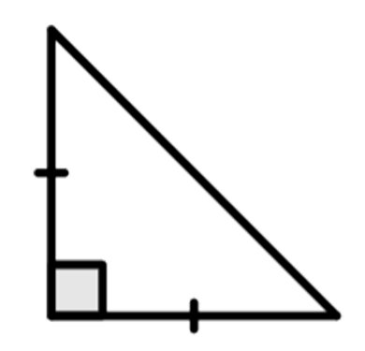
Creating shapes from triangles
You can get right-angled isosceles triangles too. What do two of these create?
A square.
Aisha
Izzy

Slide 18
Creating shapes from triangles
A parallelogram.
Aisha
Izzy

Slide 19
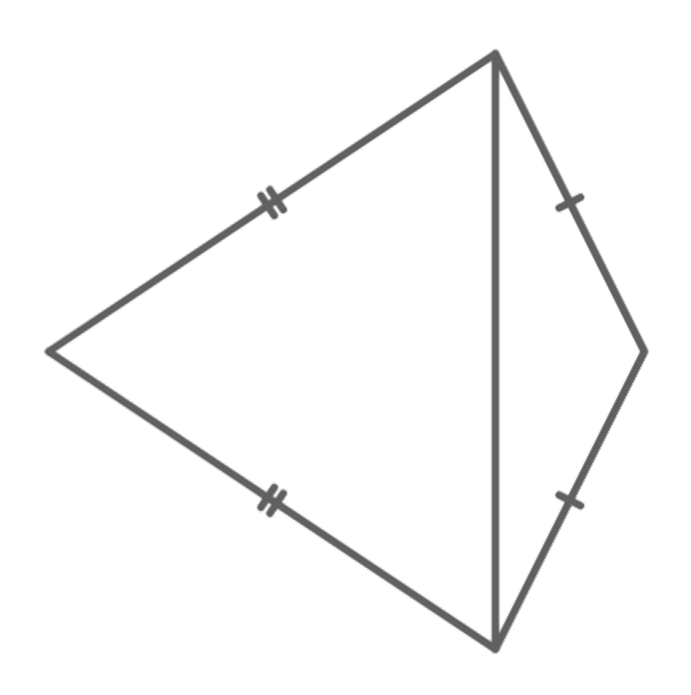
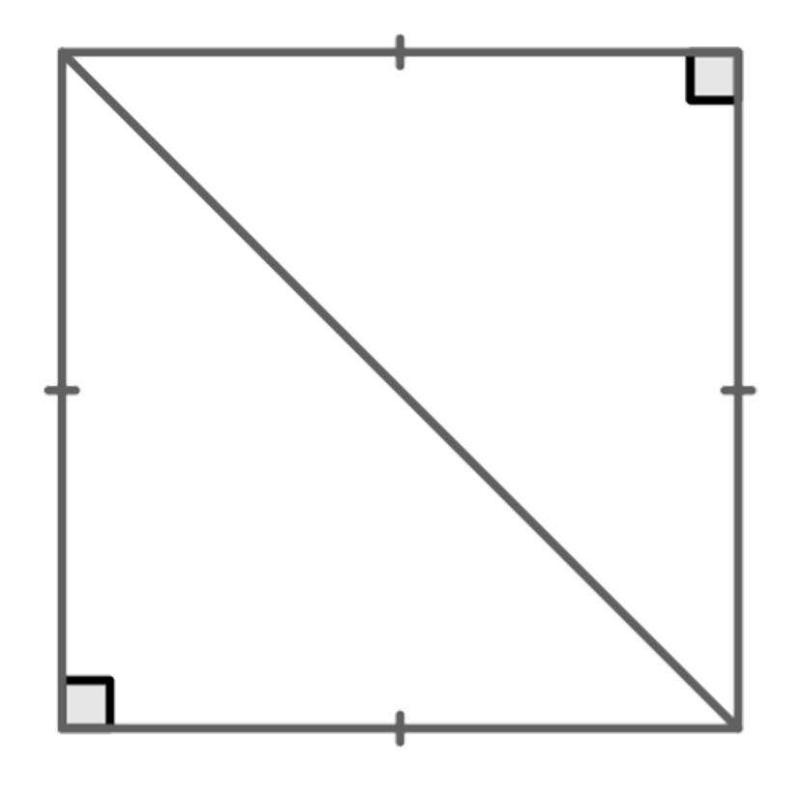
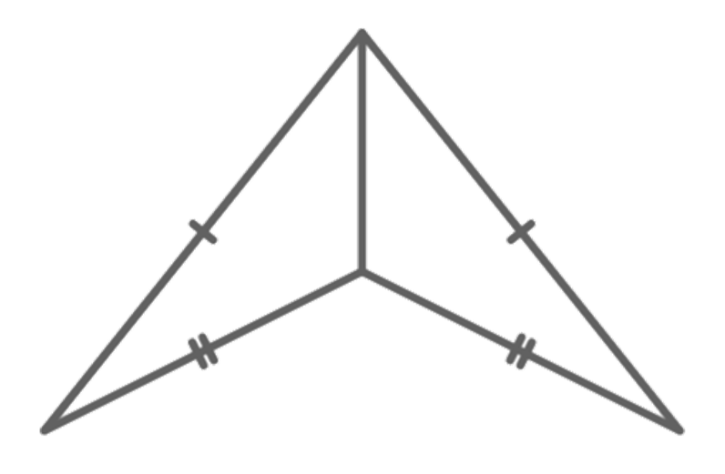
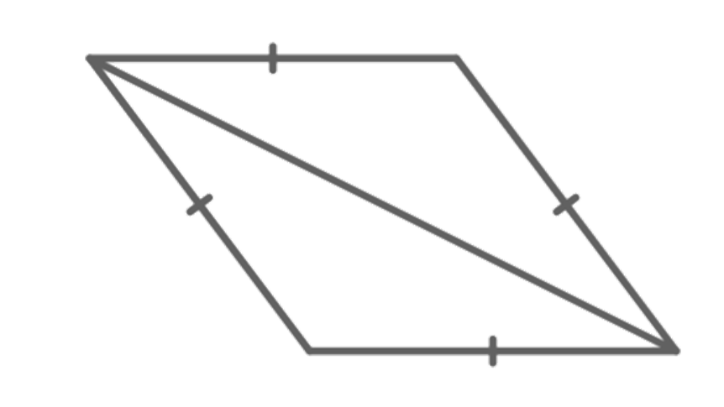
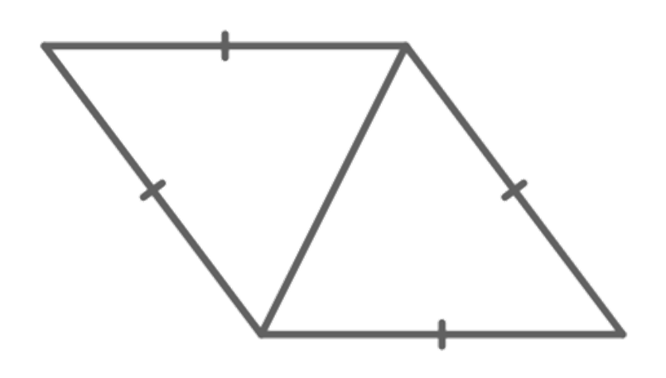
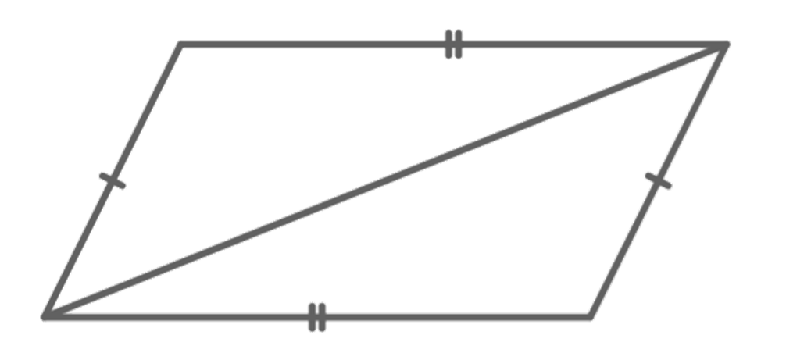
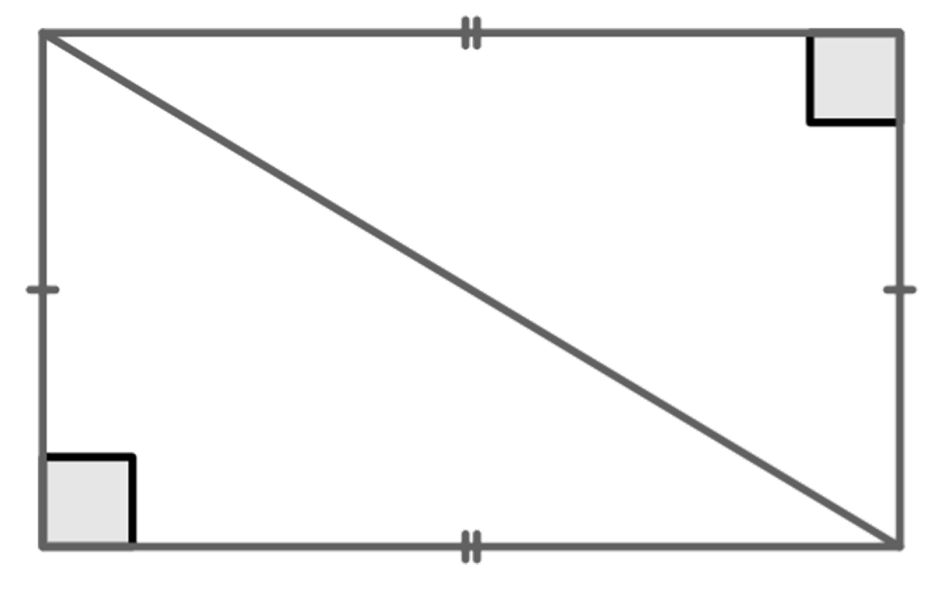
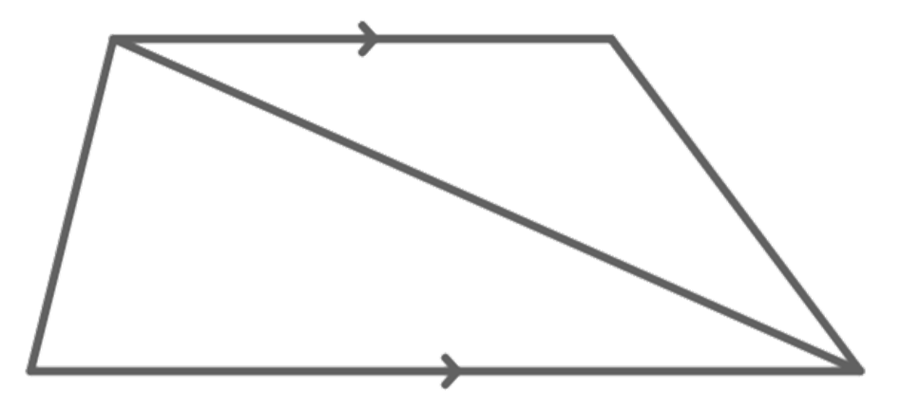
Creating shapes from triangles
1) By considering the properties of the quadrilateral, what types of triangles are they?
a
b
c
d
e
f
g
h

Slide 20
Creating shapes from triangles
1) By considering the properties of the quadrilateral, what types of triangles are they?
a
2 congruent right-angled isosceles triangles
2 congruent scalene triangles
b
c
2 congruent isosceles triangles
d
2 isosceles triangles

Slide 21
Creating shapes from triangles
1) By considering the properties of the quadrilateral, what types of triangles are they?
e
f
2 congruent scalene triangles
2 scalene triangles
g
h
2 congruent right-angled scalene triangles
2 congruent isosceles triangles

Slide 22
Constructing rhombi
Creating shapes from triangles
Constructing rhombi

Slide 23
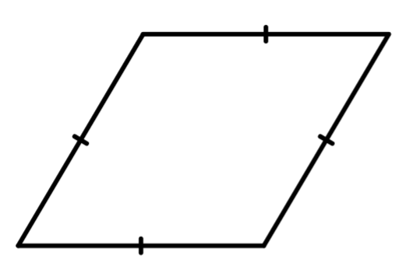
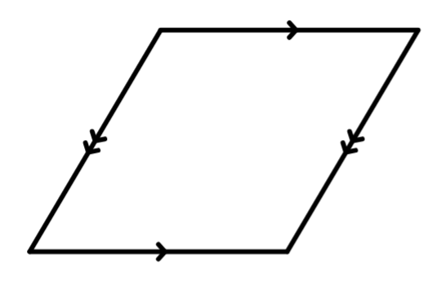
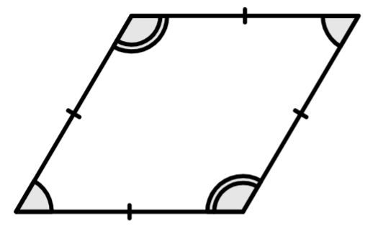
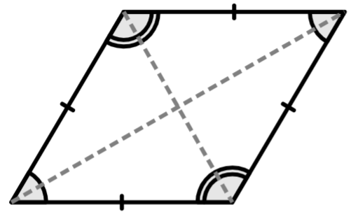
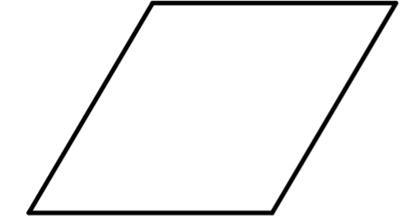
Constructing rhombi
A rhombus is a quadrilateral, just like a square, rectangle, trapezium, parallelogram, kite and other irregular quadrilaterals.
So what are the properties of a rhombus?
2 pairs of parallel sides
all edges are equal
opposite angles are equal
2 lines of symmetry

Slide 24
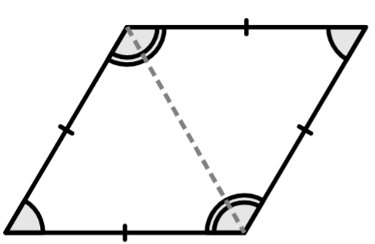
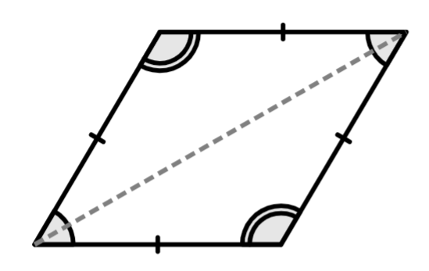
Constructing rhombi
The lines of symmetry means there are two congruent triangles in the rhombus.
As the edges are the same length on a rhombus, the triangles are isosceles.
This means we can construct any rhombus, using two congruent isosceles triangles.

Slide 25
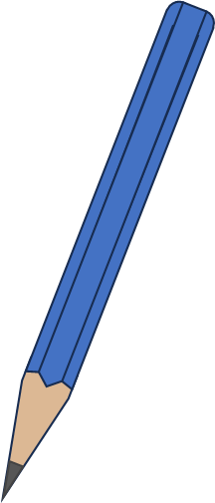
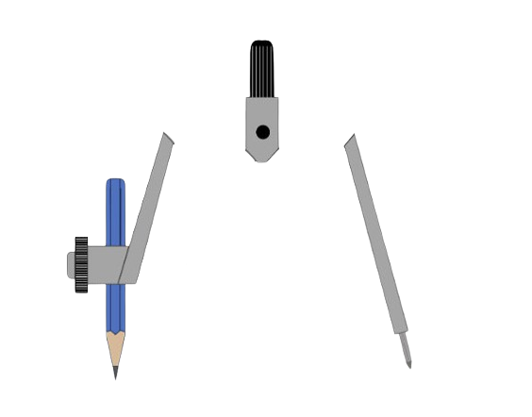

Constructing rhombi
First construct an isosceles triangle.
How big does the base of the triangles need to be?
Then using the same base line, construct the isosceles triangle underneath the line.
7 cm
7 cm
Sam
7 cm
7 cm
7 cm

Slide 26
Constructing rhombi
The base length has extended, but the edges will stay at 7 cm.
It doesn’t seem to matter!
7 cm
7 cm
Sam
7 cm
7 cm
7 cm
🖇Changing the base length

Slide 27
Constructing rhombi
There is only one unique rhombus with edge length 7 cm.
If the edge length is fixed, so is the size of the shape but that is only true for squares.
Opposite angles are equal in a rhombus, but they don’t have to be a fixed size.
🖇Changing the base length

Slide 28
Constructing rhombi
Do we need the base of the triangle to construct a rhombus?
No, it is the ends of the base edge that are important as these are opposite vertices in the rhombus.
Construct a rhombus with edges of 6 cm.
6 cm
6 cm
6 cm
6 cm
6 cm

Slide 29


Constructing rhombi
Alex has drawn two edges of a rhombus ABCD. He has challenged Sofia to construct the rest of it.
I know that B is the centre of the circle, where A and C are on the circumference.
A
B
C

Slide 30
Constructing rhombi
Alex has drawn two edges of a rhombus ABCD. He has challenged Sofia to construct the rest of it.
Which means the length of the radius BA is the edge length of the rhombus. I can set my pair of compasses to this length.
A
B
C

Slide 31
Constructing rhombi
Alex has drawn two edges of a rhombus ABCD. He has challenged Sofia to construct the rest of it.
I then need to draw an arc from A, and from C of that length.
A
B
C

Slide 32
Constructing rhombi
Alex has drawn two edges of a rhombus ABCD. He has challenged Sofia to construct the rest of it.
Well done!
The point of intersection is vertex D.
A
D
B
C

Slide 33
Constructing rhombi
A rhombus PQRS is being constructed. Locate where vertex S will be.
P
Q
S
R

Slide 34
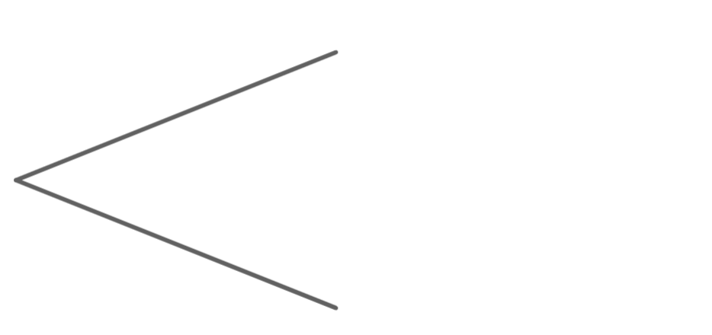
Constructing rhombi
1) Finish constructing this rhombus, from the two given sides.
2) Construct three different rhombi, with side lengths 7 cm.
3) Construct a rhombus, with a 60° angle.

Slide 35
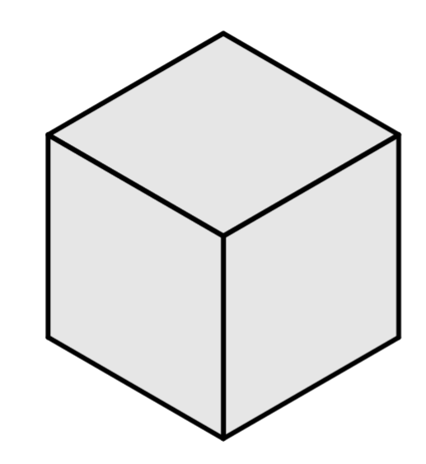
Constructing rhombi
4) Construct this isometric cube, where each face is a rhombus.
4) Construct this isometric cube, where each face is a rhombus.
Hint: The three rhombi are congruent, therefore the angles at the centre point (A) are all equal.
A

Slide 36
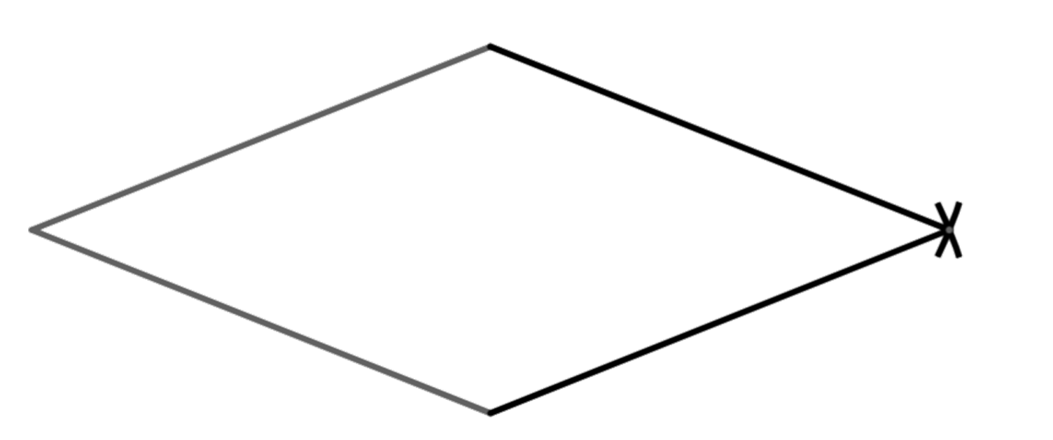
Constructing rhombi
1) Finish constructing this rhombus, from the two given sides.

Slide 37
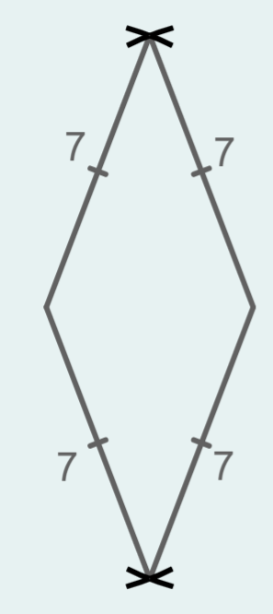
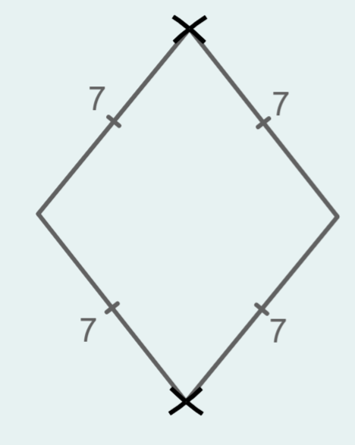
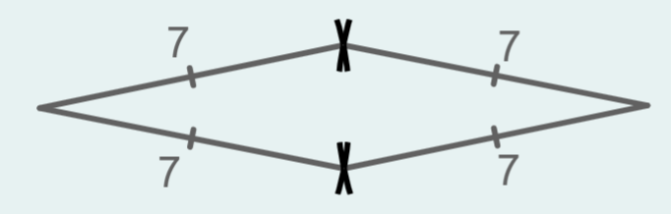
Constructing rhombi
2) Construct three different rhombi, with side lengths 7 cm.
Examples:
The base of the isosceles triangles can vary but the two edges that are equal needed to be 7 cm.

Slide 38
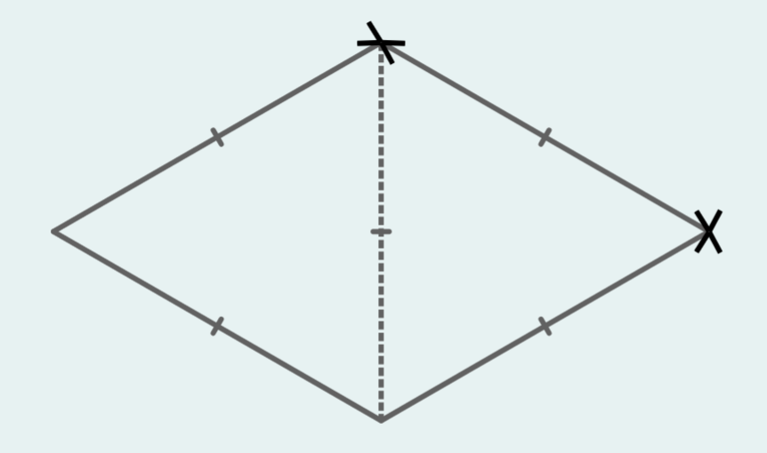
Constructing rhombi
3) Construct a rhombus, with a 60° angle.
two equilateral triangles need to be used

Slide 39
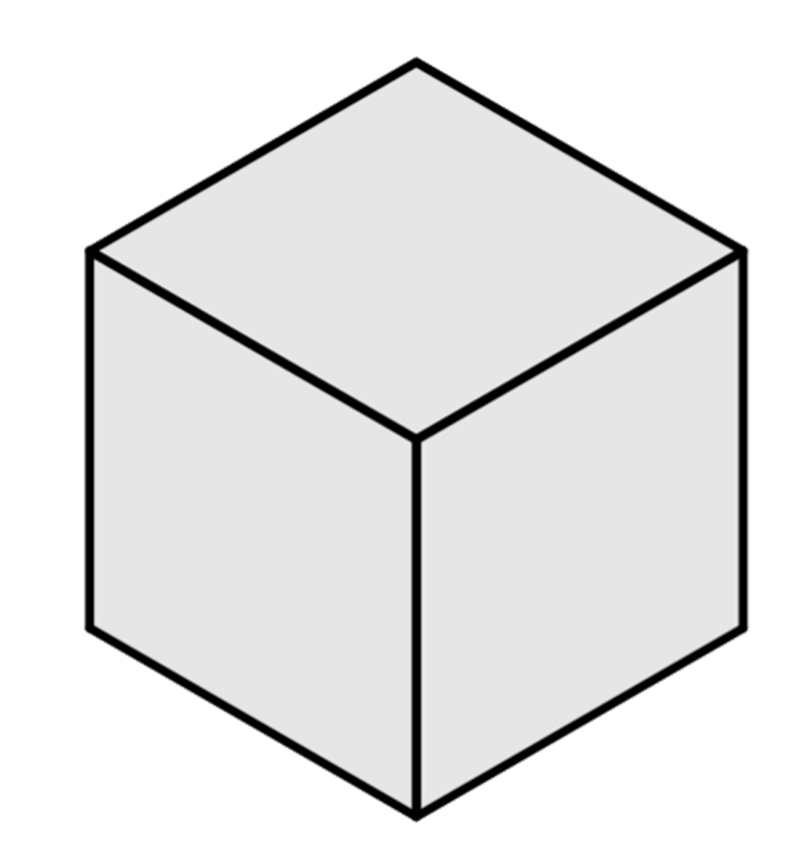
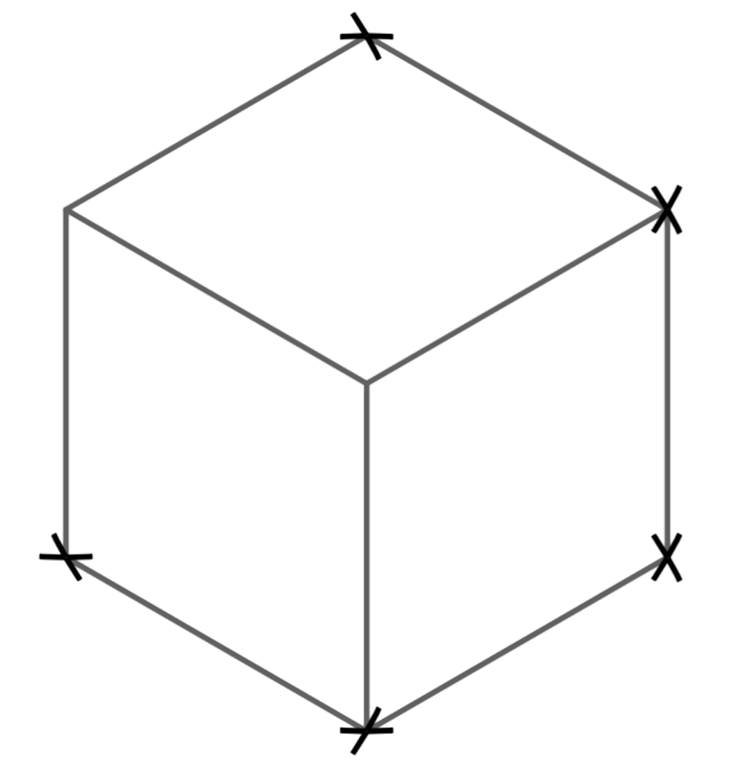
Constructing rhombi
4) Construct this isometric cube, where each face is a rhombus.
Hint: The three rhombi are congruent, therefore the angles at the centre point (A) are all equal.
60°
120°
A
120°
120°

Slide 40
Constructing rhombi
A rhombus can be constructed using two congruent isosceles triangles, joined at the base edge.
If a rhombus is constructed using two congruent equilateral triangles, then we know the interior angles are 60°, 120°, 60° and 120°.

Slide 41

© Oak National Academy 2023.
Produced in partnership with Mathematics in Education and Industry.
Licensed on the Open Government Licence v3.0, except where otherwise stated. See Oak terms and conditions.

